Slide 1
DATA607 Fall 2018 Final Presentation
DATA607 Fall 2018
John K. Hancock
Notes:
Welcome to my presentation on Relational Databases and R.

Slide 2
Sentiment Analysis:
NY Times Movie Reviews
and
Box Office Performance

Slide 3
Hypothesis Test
H0: The sentiment of a NY Times review has no effect on the box office performance of a movie
HA: The sentiment of a NY Times review has an effect on the box office performance of a movie

Slide 4
Project Methodology
Data was collected from two sources, the NY Times API and the website the-numbers.com
Data was explored, cleaned, and prepared for Sentiment Analysis
Perform tidytext sentiment analysis using the NRC, Bing, and AFINN lexicon
Regression analysis between the sentiment and box office performance

Slide 5
Data Collection
Web scrape the-numbers.com website tracks 2018 box office gross figures
NYTimes API for the movie reviews
Issues with collection
Saved results into csv files

Slide 6
Data Transformation
Collected 526 observations over 9 variables from the numbers website
Collected 1,040 observations over 18 variables from the NY Times API call
Transformed key variables from characters to numeric
Cleaned the critics variable to normalize spelling
Combined both datasets into the Movies dataset

Slide 7
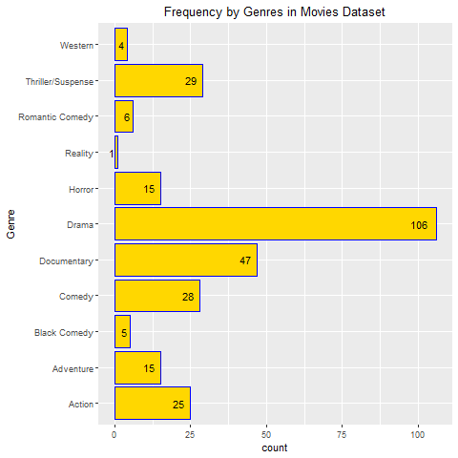
Data Exploration Highlights

Slide 8
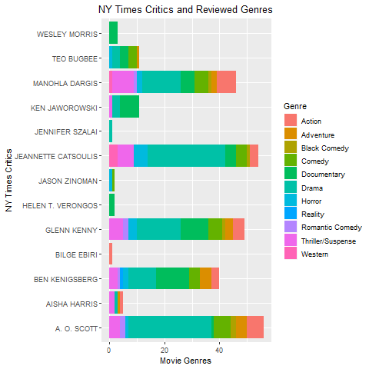
Data Exploration Highlights

Slide 9
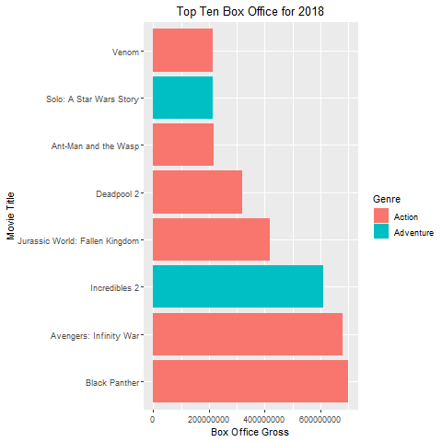
Data Exploration Highlights

Slide 10
Tidytext Sentiment Analysis – Data Preparation
Remove contractions, undesirable words, and stopwords
Unnest the Reviews in the Movies dataset
Provide the counts of words in the Review per Movie title

Slide 11
TidyText Sentiment Analysis
Senitment lexicons – NRC, Bing, and AFINN
Based on unigrams (single words)
Contains English words
Scores and/or sentiments are assigned to each word
All individual words in each review is either categorized or scored as “positive” or “negative” sentiment
Tidytext tbl is joined to each lexicon

